Slide 1
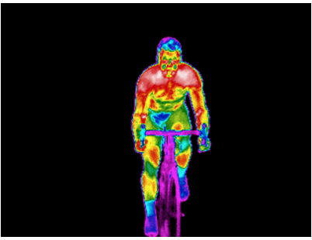
Thermal Imaging in Exercise and Sports Science

Slide 2
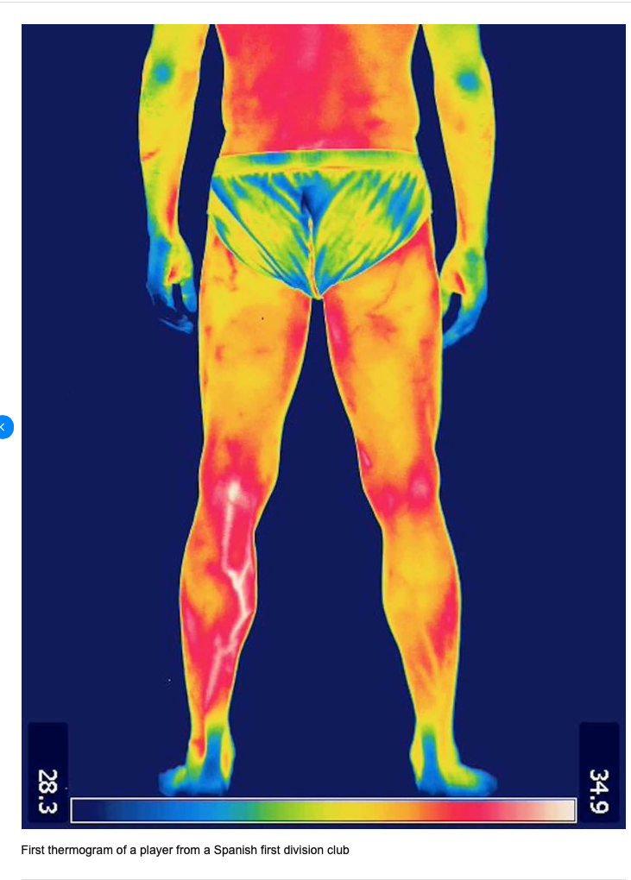
Player from a Spanish First Division Club

Slide 3
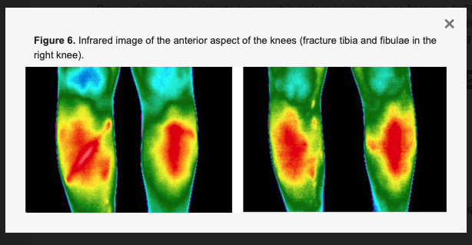

Slide 4
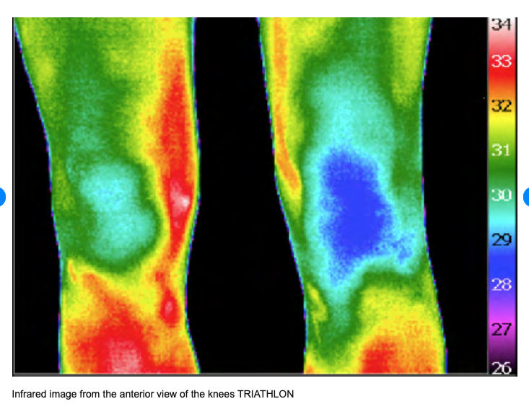

Slide 5
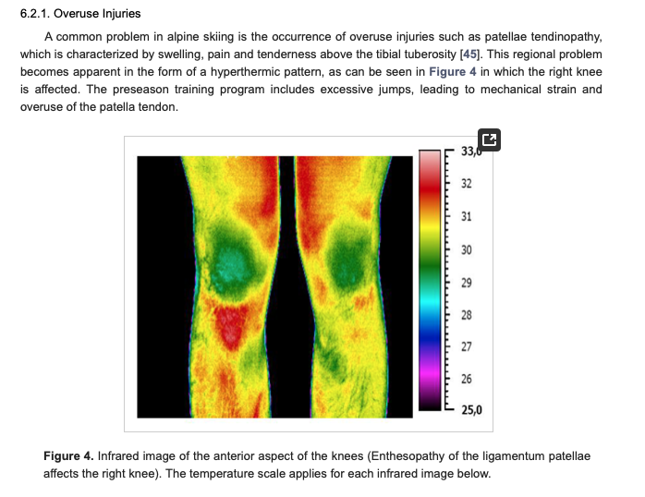

Slide 6
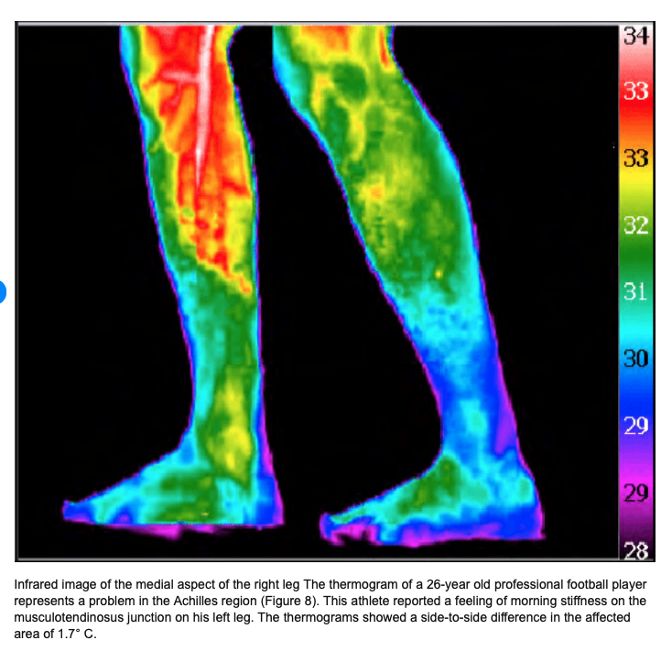

Slide 7
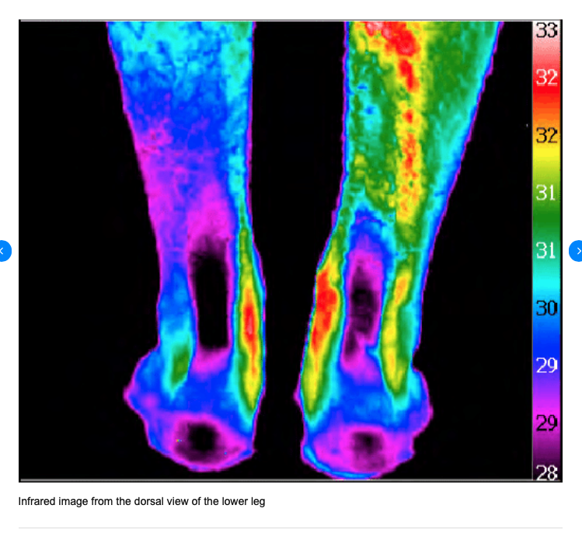

Slide 8
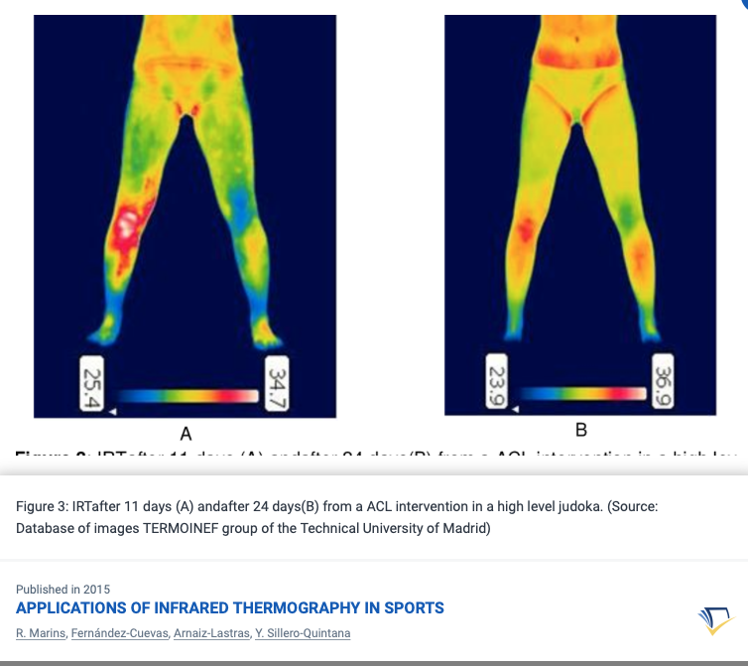

Slide 9
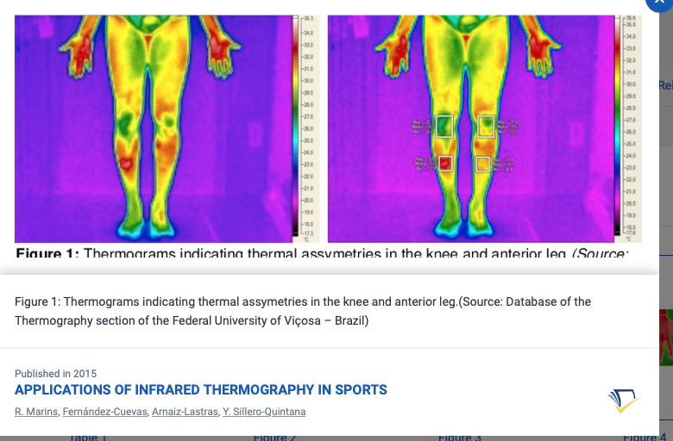

Slide 10
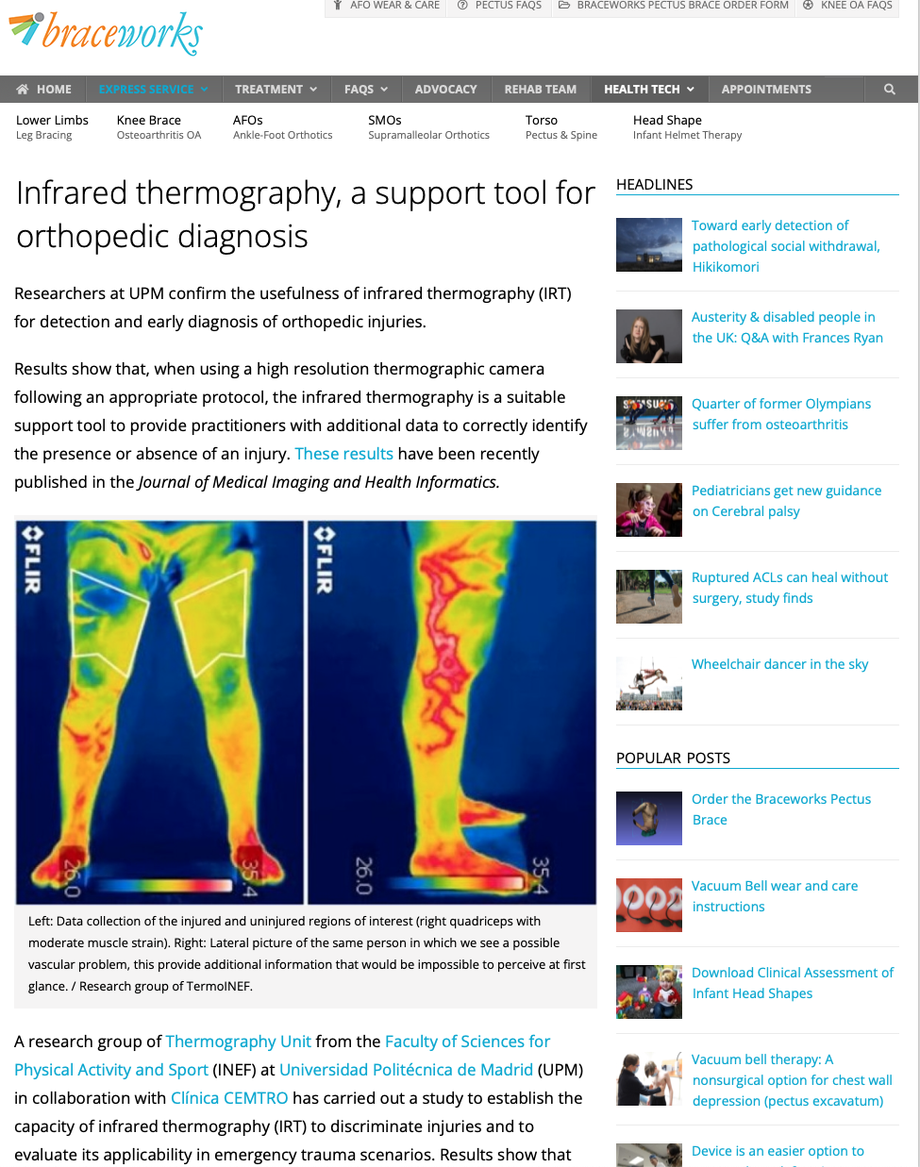

Slide 11
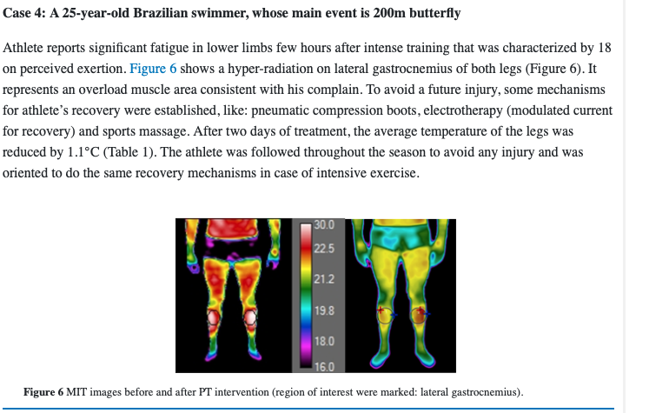

Slide 12
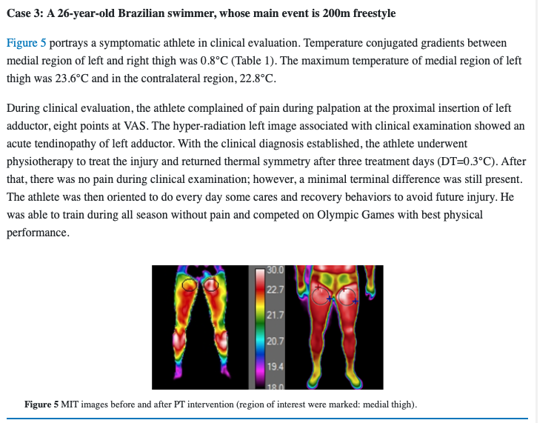

Slide 13
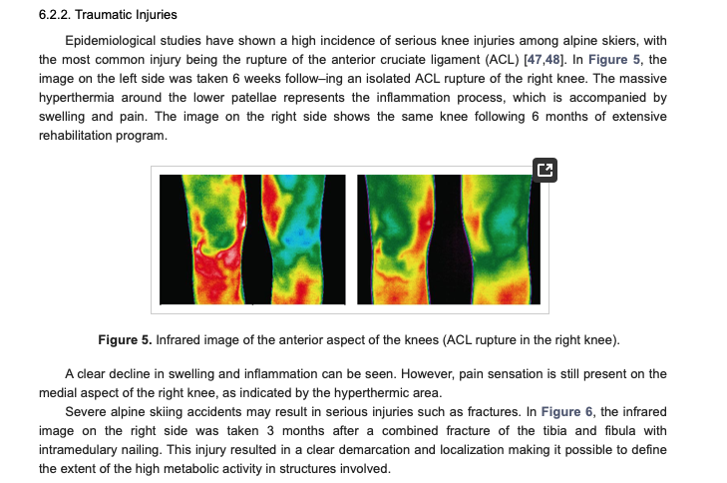

Slide 14
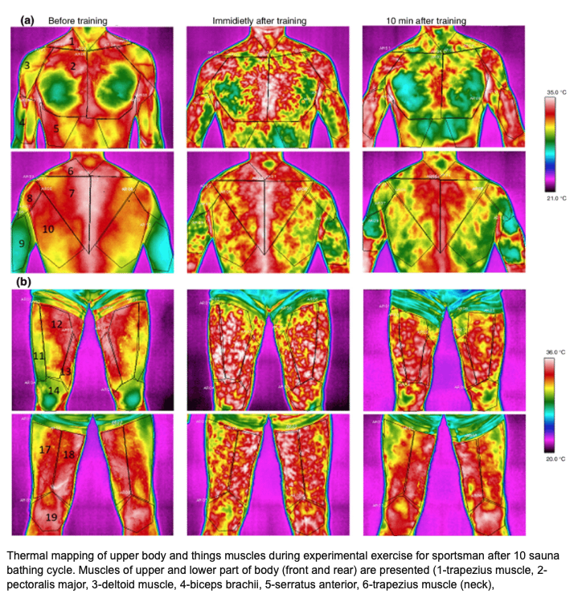

Slide 15
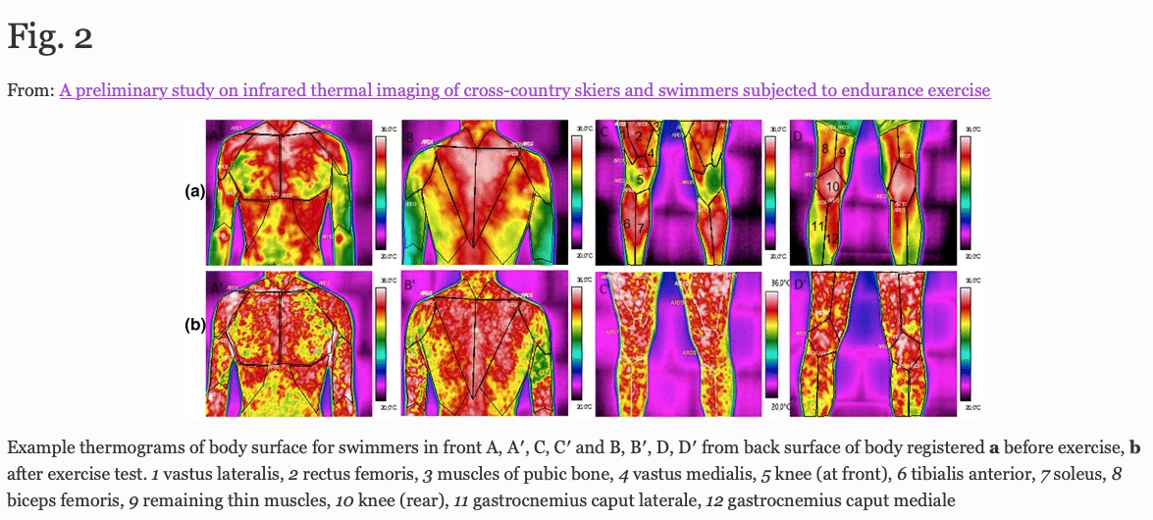

Slide 16
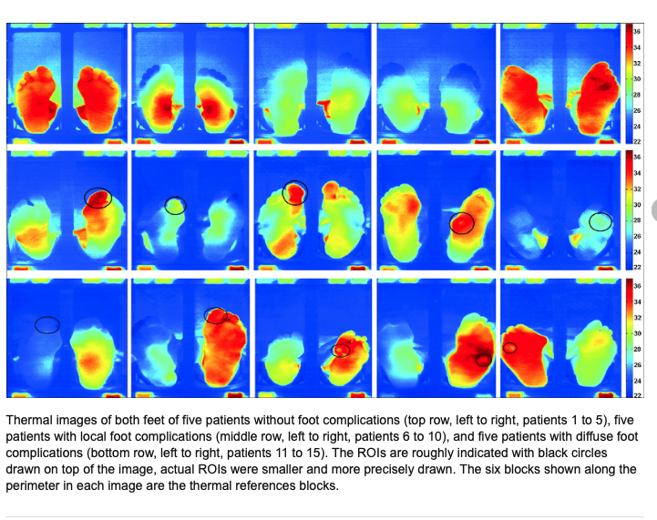

Slide 17
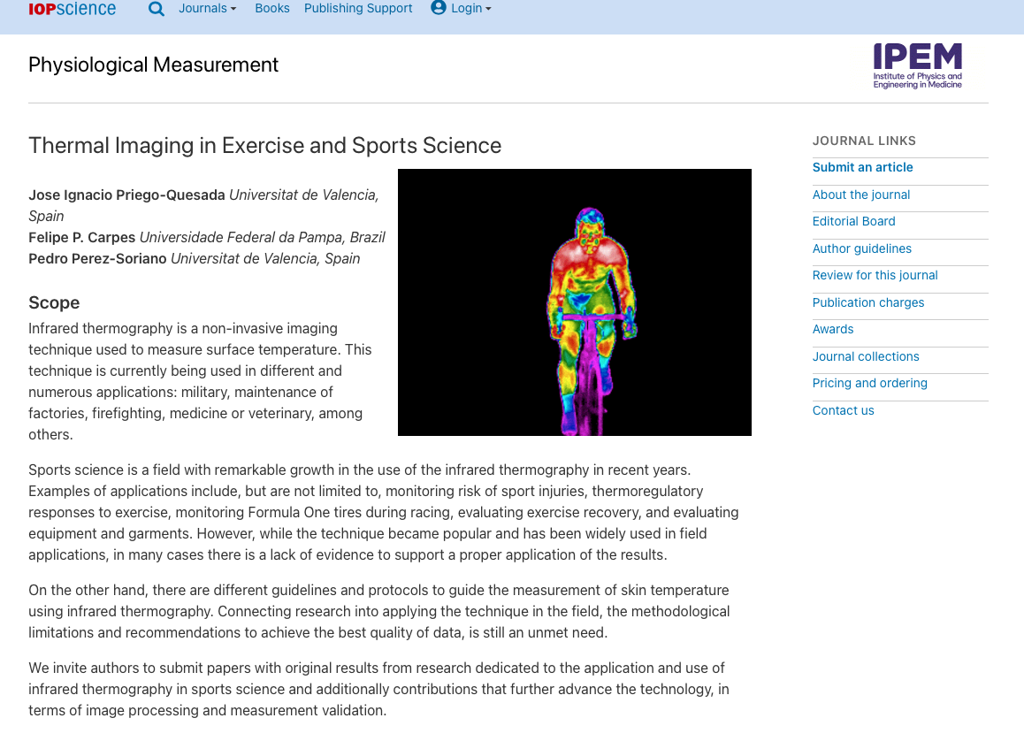

Slide 18
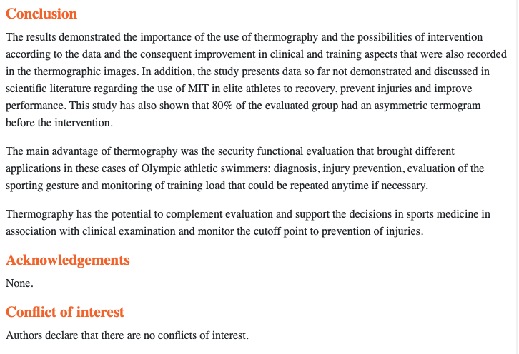

Slide 19
Non-invasive: Thermal imaging is a non-invasive technique, which means it does not require any contact with the subject's body, making it a practical tool for monitoring athletes during exercise. (Sabbahi et al., 2019)
Real-time monitoring: Thermal imaging provides real-time information on changes in skin temperature, allowing coaches and trainers to adjust training strategies and identify potential risks. (Al-Nakeeb et al., 2018)
Early detection of injuries: Thermal imaging can detect areas of the body that are experiencing abnormal heat, which may indicate an injury before it becomes apparent through other means, allowing for earlier intervention. (Buchheit et al., 2015)
Quantifiable data: Thermal imaging produces quantifiable data that can be analyzed and compared over time to identify trends and measure improvements. (Makowski and Casamento-Moran, 2019)
Identification of asymmetries: Thermal imaging can identify asymmetries in temperature between the left and right sides of the body, which can be an early indicator of potential injury. (Nelson et al., 2015)
Objective assessment of recovery: Thermal imaging can objectively assess the rate of recovery from injury or fatigue by monitoring changes in skin temperature over time. (Gordon et al., 2019)
Evaluating performance: Thermal imaging can be used to evaluate performance by measuring the heat generated by active muscle groups and identifying areas where there may be room for improvement. (Fonseca et al., 2018)
Individualized training: Thermal imaging can be used to customize training programs for individual athletes based on their unique thermal profiles, maximizing the effectiveness of the training program. (Ebersole et al., 2017)
Multimodal approach: Thermal imaging can be combined with other technologies such as heart rate monitoring and GPS to provide a comprehensive assessment of an athlete's physical condition. (McCarron et al., 2016)
Improved injury prevention: By monitoring changes in skin temperature, thermal imaging can help identify potential areas of weakness in an athlete's body, allowing for targeted intervention to prevent injuries. (Rao et al., 2020)

